Slide 1
Recurrent Autoencoder Networks for Koopman Spectral Analysis
Samuel Otto

Slide 2
The Koopman Operator

Slide 3
EDMD Approximation

Slide 4
Kernel DMD Approximation

Slide 5
Deep Learning Approach
Want: linear dynamics in an intrinsic feature space comprised of nonlinear observables
Use autoencoder to learn an optimal set of nonlinear observables
Nonlinear encoder and decoder
Constrain dynamics to be linear in the intrinsic feature space
Autoencoder need not be contractive since having linear dynamics is a strong constraint.

Slide 6



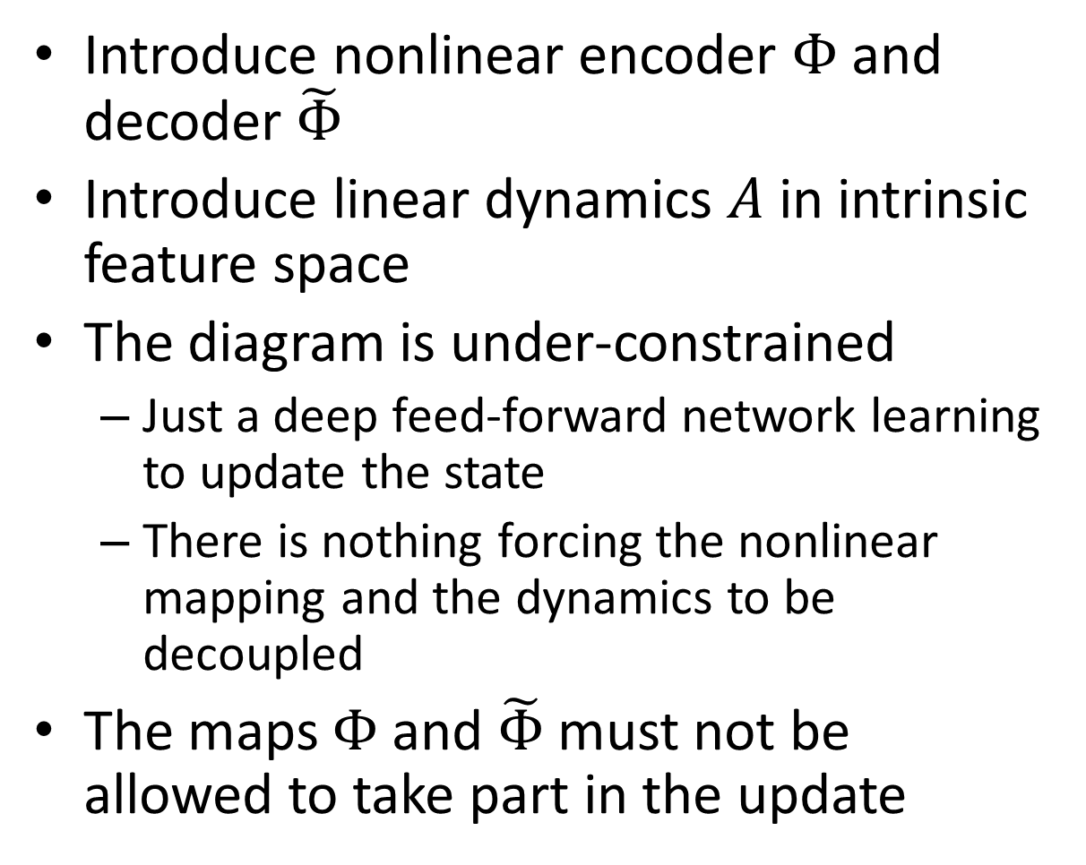




Naïve Approach
Introduce nonlinear encoder $Φ$ and decoder $\tilde{Φ}$
Introduce linear dynamics $A$ in intrinsic feature space
The diagram is under-constrained
Just a deep feed-forward network learning to update the state
There is nothing forcing the nonlinear mapping and the dynamics to be decoupled
The maps $Φ$ and $\tilde{Φ}$ must not be allowed to take part in the update
$${\hat{x}}_{n+1}$$
$$\tilde{Φ}$$
$$z_{n+1}$$
$$A$$
$$z_{n}$$
$$Φ$$
$$x_{n}$$

Slide 7







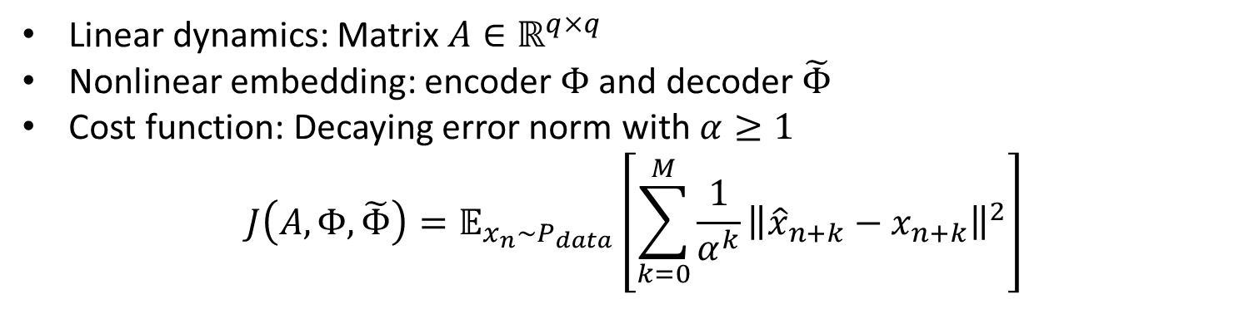










Recurrent Autoencoder Network (I)
Teacher: $x_{n}$
Teacher: $x_{n+1}$
Teacher: $x_{n+2}$
$${\hat{x}}_{n}$$
$${\hat{x}}_{n+1}$$
$${\hat{x}}_{n+2}$$
$$\tilde{Φ}$$
$$\tilde{Φ}$$
$$\tilde{Φ}$$
$$z_{n}$$
$$A$$
$$A$$
$$A$$
$$⋯$$
$$z_{n+1}$$
$$z_{n+2}$$
$$Φ$$
$$x_{n}$$
Linear dynamics: Matrix $A∈ℝ^{q×q}$
Nonlinear embedding: encoder $Φ$ and decoder $\tilde{Φ}$
Cost function: Decaying error norm with $α≥1$
$$J\left(A,Φ,\tilde{Φ}\right)=𝔼_{x_{n}\sim P_{data}}\left[\sum_{k=0}^{M}{\frac{1}{α^{k}}{\left\|{\hat{x}}_{n+k}−x_{n+k}\right\|}^{2}}\right]$$

Slide 8









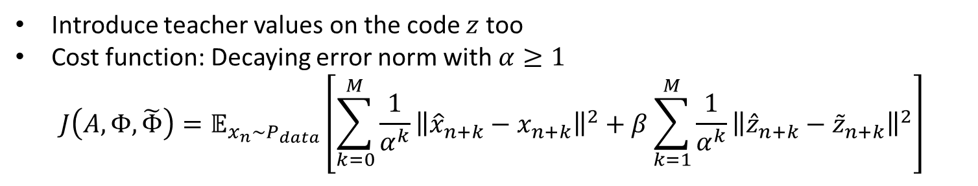














Recurrent Autoencoder Network (II)
Teacher: $x_{n}$
Teacher: $x_{n+1}$
Teacher: $x_{n+2}$
$${\hat{x}}_{n}$$
$${\hat{x}}_{n+1}$$
$${\hat{x}}_{n+2}$$
$$\tilde{Φ}$$
$$\tilde{Φ}$$
$$\tilde{Φ}$$
$$z_{n}$$
$$A$$
$$A$$
$$A$$
$$⋯$$
$${\hat{z}}_{n+1}$$
$${\hat{z}}_{n+2}$$
$${\tilde{z}}_{n+1}$$
$${\tilde{z}}_{n+2}$$
$$Φ$$
$$Φ$$
$$Φ$$
$$x_{n}$$
Teacher: $x_{n+1}$
Teacher: $x_{n+2}$
Introduce teacher values on the code $z$ too
Cost function: Decaying error norm with $α≥1$
$$J\left(A,Φ,\tilde{Φ}\right)=𝔼_{x_{n}\sim P_{data}}\left[\sum_{k=0}^{M}{\frac{1}{α^{k}}{\left\|{\hat{x}}_{n+k}−x_{n+k}\right\|}^{2}}+β\sum_{k=1}^{M}{\frac{1}{α^{k}}{\left\|{\hat{z}}_{n+k}−{\tilde{z}}_{n+k}\right\|}^{2}}\right]$$

Slide 9
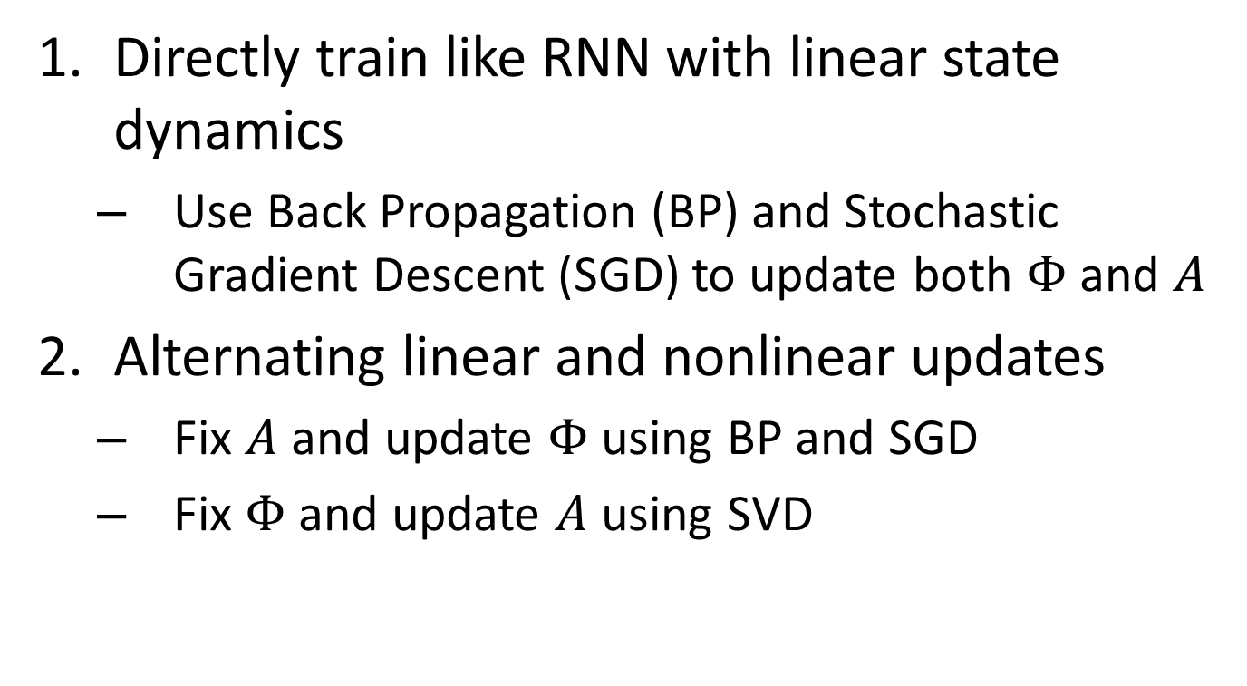
Training Methodology
Directly train like RNN with linear state dynamics
Use Back Propagation (BP) and Stochastic Gradient Descent (SGD) to update both $Φ$ and $A$
Alternating linear and nonlinear updates
Fix $A$ and update $Φ$ using BP and SGD
Fix $Φ$ and update $A$ using SVD

Slide 10
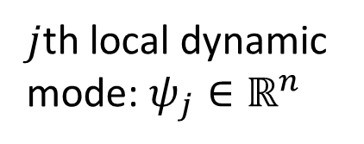


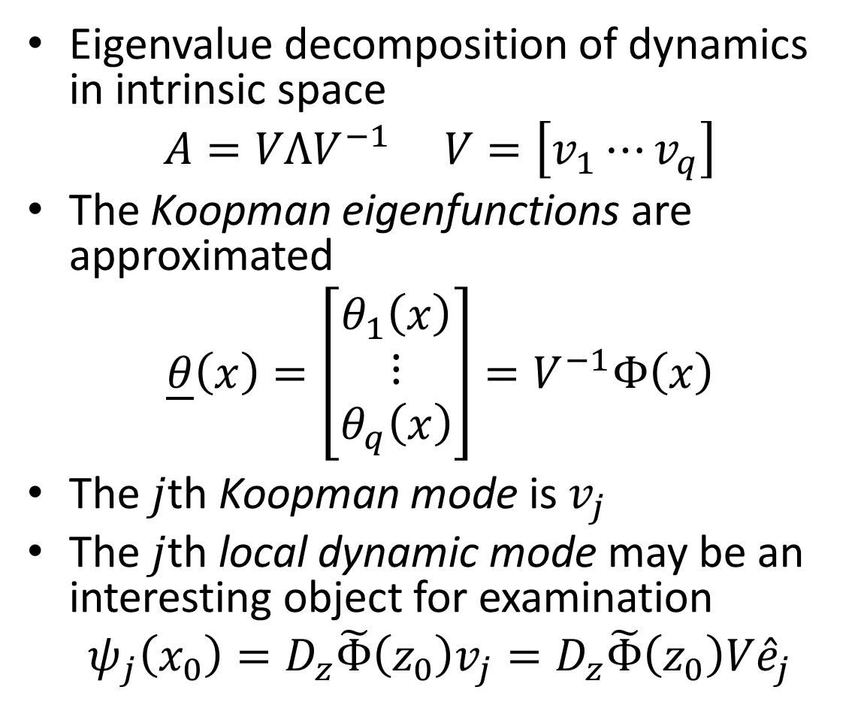





Koopman Spectral Analysis
$j$th local dynamic
mode: $ψ_{j}∈ℝ^{n}$
$$D_{z}\tilde{Φ}$$
Eigenvalue decomposition of dynamics in intrinsic space
$$A=VΛV^{−1} V=\left[v_{1}⋯v_{q}\right]$$
The Koopman eigenfunctions are approximated
$$\underline{θ}\left(x\right)=\left[\begin{aligned}θ_{1}\left(x\right) \\ ⋮ \\ θ_{q}\left(x\right)\end{aligned}\right]=V^{−1}Φ\left(x\right)$$
The $j$th Koopman mode is $v_{j}$
The $j$th local dynamic mode may be an interesting object for examination
$$ψ_{j}\left(x_{0}\right)=D_{z}\tilde{Φ}\left(z_{0}\right)v_{j}=D_{z}\tilde{Φ}\left(z_{0}\right)V{\hat{e}}_{j}$$
$$V$$
$${\hat{e}}_{j}∈ℝ^{q}$$
Koopman
eigenfunctions:
$\underline{θ}\left(x\right)∈ℝ^{q}$
$$V^{−1}$$
$$Φ$$
$$x∈ℝ^{n}$$

Slide 11
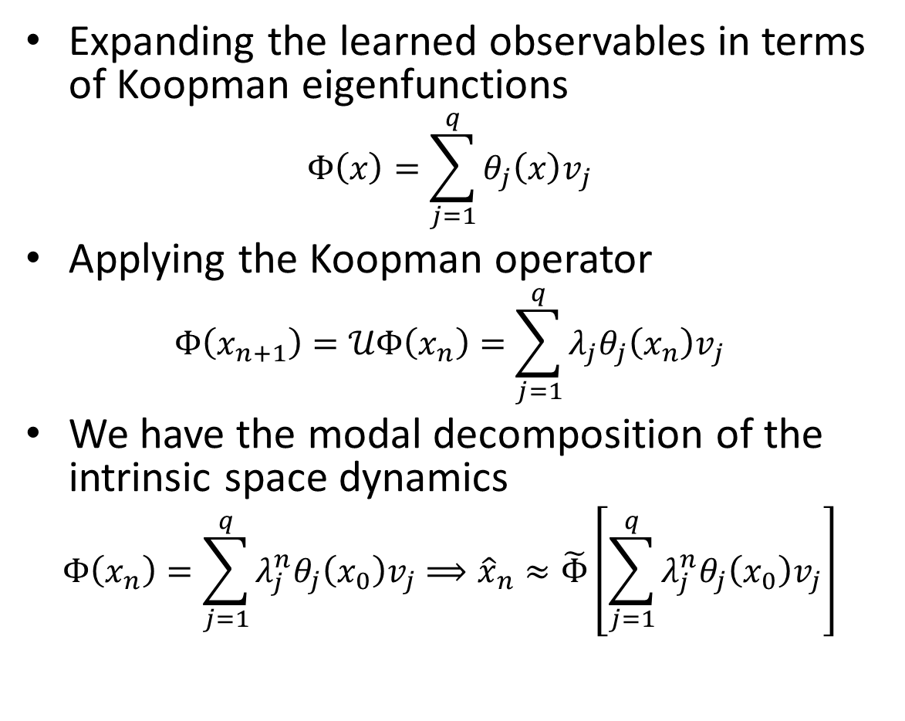
Koopman Spectral Analysis
$j$th local dynamic
mode: $ψ_{j}∈ℝ^{n}$
$$D_{z}\tilde{Φ}$$
Expanding the learned observables in terms of Koopman eigenfunctions
$$Φ\left(x\right)=\sum_{j=1}^{q}{θ_{j}\left(x\right)v_{j}}$$
Applying the Koopman operator
$$Φ\left(x_{n+1}\right)=𝒰Φ\left(x_{n}\right)=\sum_{j=1}^{q}{λ_{j}θ_{j}\left(x_{n}\right)v_{j}}$$
We have the modal decomposition of the intrinsic space dynamics
$$Φ\left(x_{n}\right)=\sum_{j=1}^{q}{λ_{j}^{n}θ_{j}\left(x_{0}\right)v_{j}}⟹{\hat{x}}_{n}≈\tilde{Φ}\left[\sum_{j=1}^{q}{λ_{j}^{n}θ_{j}\left(x_{0}\right)v_{j}}\right]$$
$$V$$
$${\hat{e}}_{j}∈ℝ^{q}$$
Koopman
eigenfunctions:
$\underline{θ}\left(x\right)∈ℝ^{q}$
$$V^{−1}$$
$$Φ$$
$$x∈ℝ^{n}$$

Slide 12



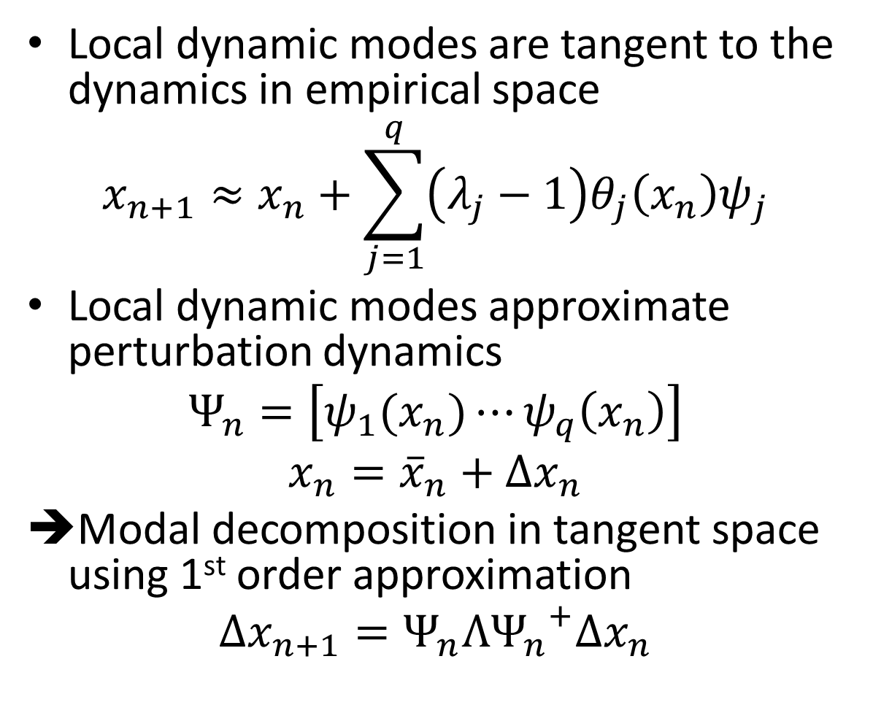





Koopman Spectral Analysis
Local dynamic modes are tangent to the dynamics in empirical space
$$x_{n+1}≈x_{n}+\sum_{j=1}^{q}{\left(λ_{j}−1\right)θ_{j}\left(x_{n}\right)ψ_{j}}$$
Local dynamic modes approximate perturbation dynamics
$$Ψ_{n}=\left[ψ_{1}(x_{n})⋯ψ_{q}\left(x_{n}\right)\right]$$
$$x_{n}={\overline{x}}_{n}+Δx_{n}$$
Modal decomposition in tangent space using 1st order approximation
$$Δx_{n+1}=Ψ_{n}Λ{Ψ_{n}^{}}^{+}Δx_{n}$$
$$Δx=ΨΔh$$
$$\tilde{Φ}$$
$$V$$
$$Δh∈ℝ^{q}$$
$$Δh≈Ψ^{+}Δx$$
$$V^{−1}$$
$$Φ$$
$$Δx∈ℝ^{n}$$

